Slide 1

Process Mining Virtual Internship
by
P. Pavithra
Roll No. 224G5A3210
Department of Computer Science and Engineering (Data Science)
Srinivasa Ramanujan Institute of Technology
(Affiliated to JNTUA & Approved by AICTE) (Accredited by NAAC with ‘A’ Grade & Accredited by NBA (EEE, ECE & CSE)
Rotarypuram Village, B K Samudram Mandal, Ananthapuramu – 515701.
2023 - 2024

Slide 2

Contents
Course Objective
Introduction
Technology
Applications
Modules
Real Time applications
Learning outcomes
GitHub Link
Queries

Slide 3
Course Objective
To understand the basics of Process mining and its significance in optimizing business processes.
Learn how to extract, clean, and transform raw data from raw data to make it suitable for process mining.
Compare discovered process models with predefined process models to identify deviations.
Identify areas where process efficiency can be improved.
Apply the skills and knowledge gained throughout the internship to a real-world business case or project.

Slide 4

Contd..

Slide 5
Introduction
Process Mining:
Analysing processes using Event log data.
Business have lots of processes:
Shipping Orders
Hiring Employees
Repairing equipment
Paying Suppliers
Resolving Customer Complaints……

Slide 6
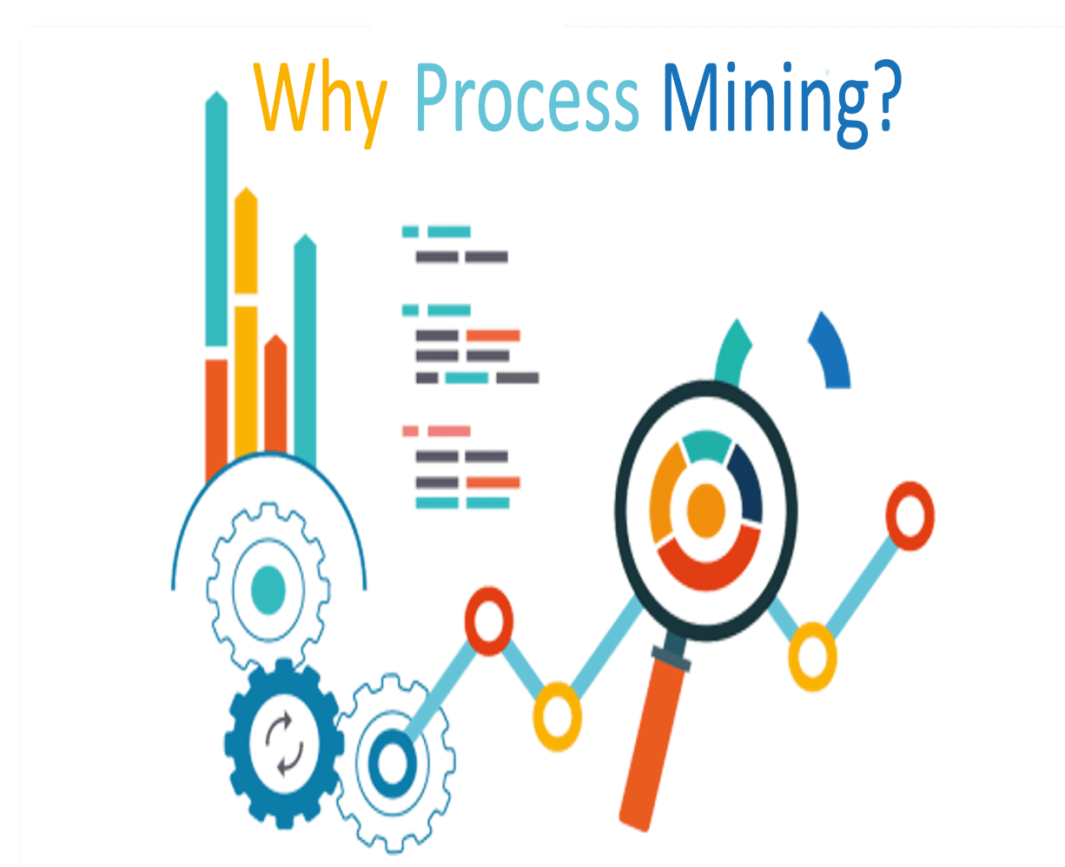
Contd..
Why we need Process Mining:
Used to analyse the “as is” process.
To know how the process is currently performed.
To adapt the incremental approach in companies.
To visualise the processes using maps...

Slide 7
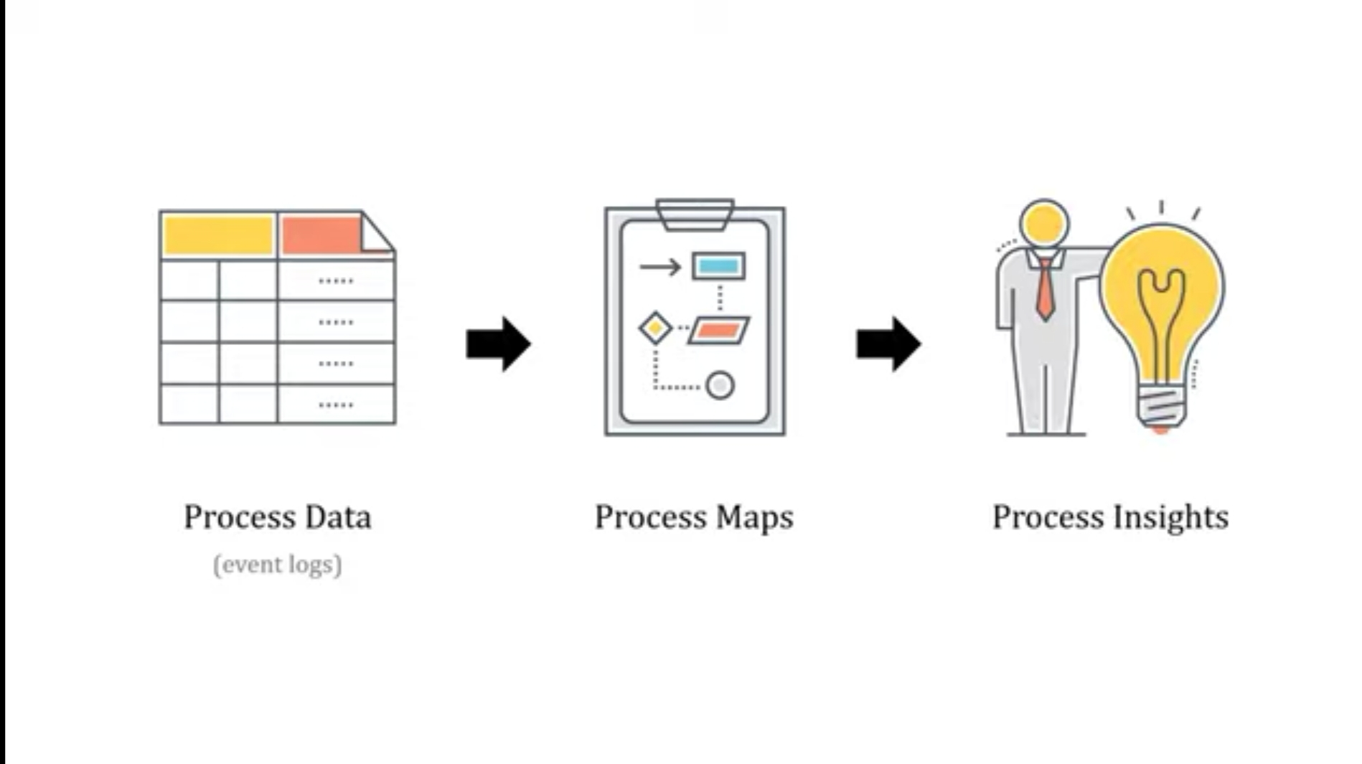
Contd..
How it works?

Slide 8
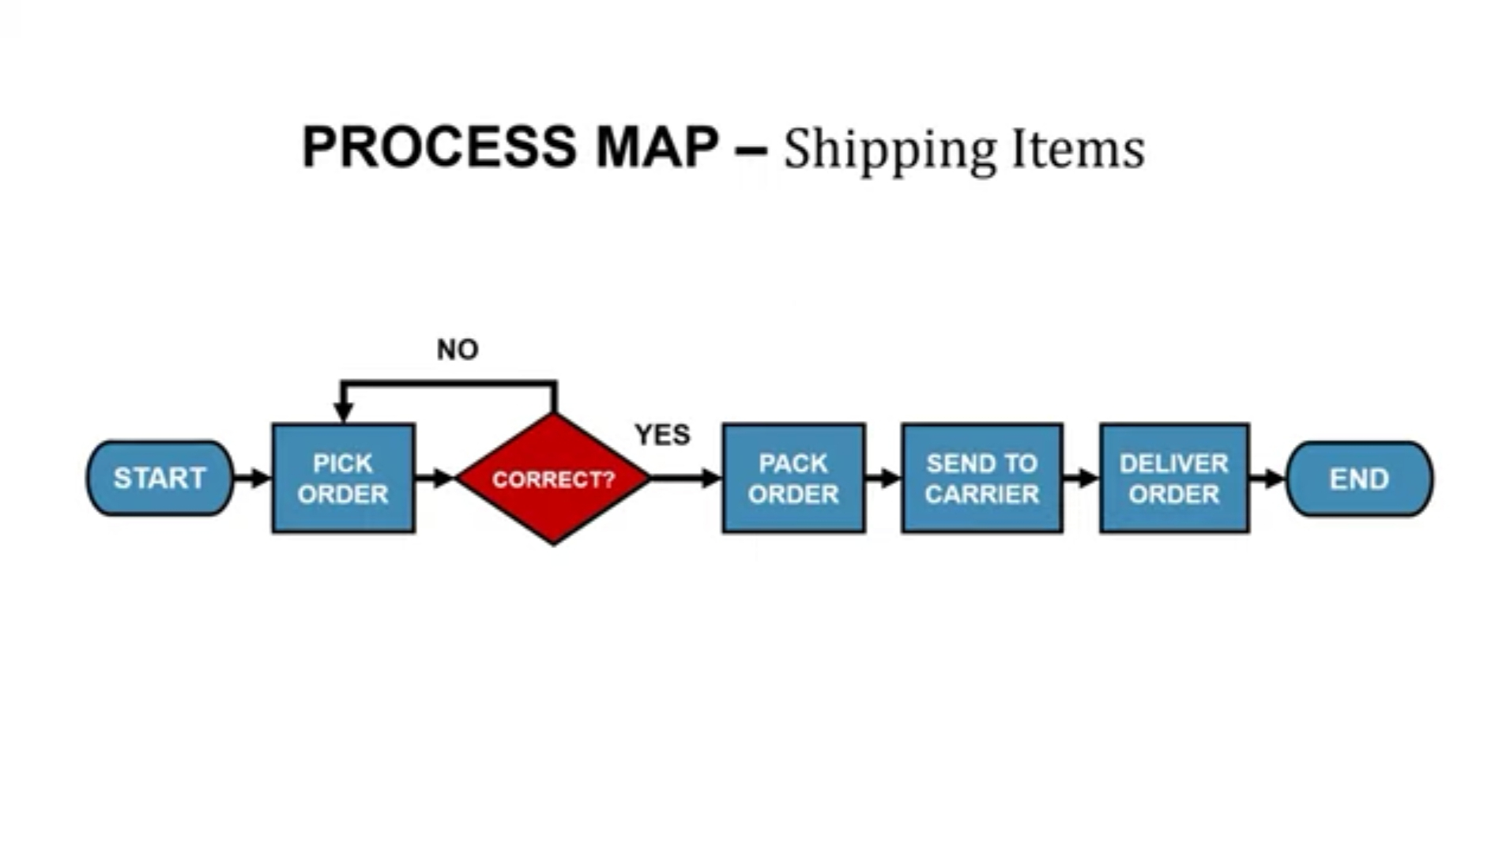
Contd..
Process Mapping: Helps us to understand and improve those processes.
Example:

Slide 9
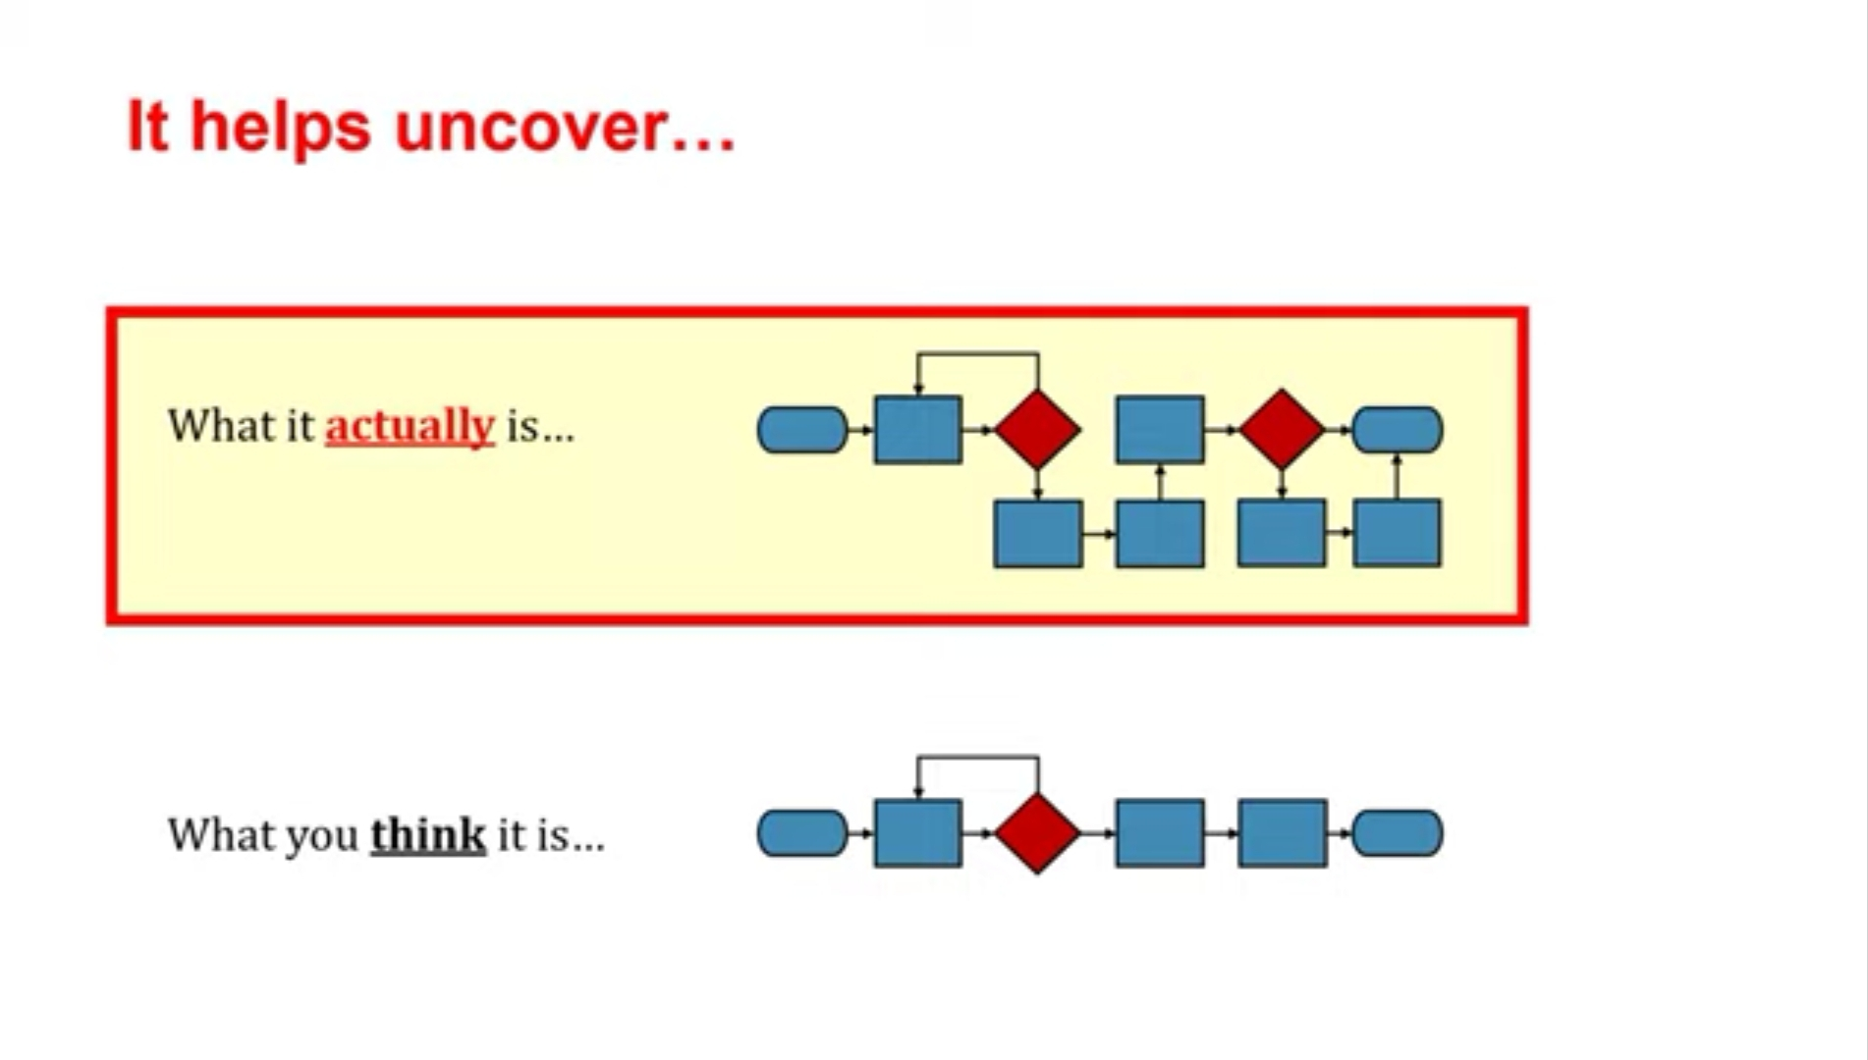
Contd..
Process Mapping:

Slide 10
Technology
Data Collection: Process mining starts with collecting event data from various sources that record process-related events.
Event Logs: The collected data is stored in event logs, which contain timestamped records of activities, transactions, and interactions within the organization's processes.
Preprocessing: Before analysis can begin, the event logs are cleaned, transformed, and structured to remove noise and inconsistencies. This ensures that the data is accurate and can be effectively analyzed.
4.Analysis and Visualization: Process mining tools provide various visualizations and metrics to help organizations understand their processes better.
5. Optimization:This can lead to targeted changes that enhance efficiency, reduce costs, and improve overall performance.
6.Implementation and Control: The insights gained from process mining can be used to guide process redesign and implementation efforts.

Slide 11
Applications
Process Discovery
HR Process Optimization
Healthcare Process Analysis
Customer Journey Analysis
Supply Chain Optimization
Conformance Checking
Performance Analysis
Resource Utilization
Risk management
Customer Journey Analysis

Slide 12
Modules:
Introduction to Process Mining
Process Mining Fundamentals
Write PQL Queries
Get Data into the EMS

Slide 13
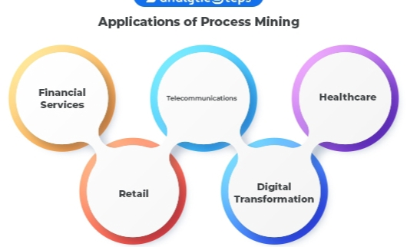
Real Time Applications:
Supply Chain Management
Manufacturing
Healthcare Workflow Optimization
Fraud Detection
Transportation
Financial Management…

Slide 14
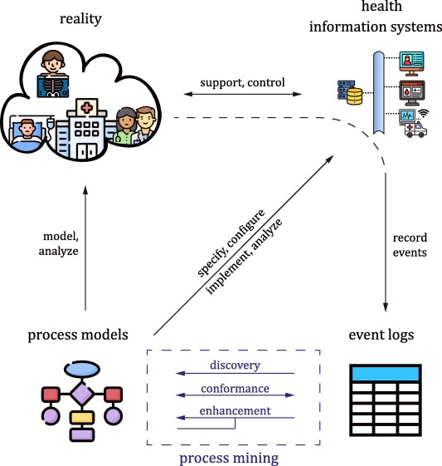
Contd..
Healthcare Optimization:

Slide 15
Learning Outcomes
Practical Application of Process Mining Tools: Interns gain hands-on experience with process mining tools, learning how to load data, preprocess event logs, create process models, and analyze results.
Data Handling and Preprocessing Skills: Interns become proficient in cleaning, transforming, and preparing event data for analysis, enhancing their data manipulation skills.
Visualization Skills: Interns create various process visualizations, such as process flowcharts, performance graphs, and resource utilization plots, improving their ability to convey insights visually.
Real-Time Monitoring: For real-time applications, interns gain experience in monitoring and analyzing live event data to ensure smooth process operations.
Problem-Solving and Decision-Making: Interns learn how to interpret process mining results and make data-driven decisions to address process challenges.
Project Management: Interns manage their projects, plan tasks, allocate time, and meet deadlines, gaining project management skills applicable in various contexts.

Slide 16
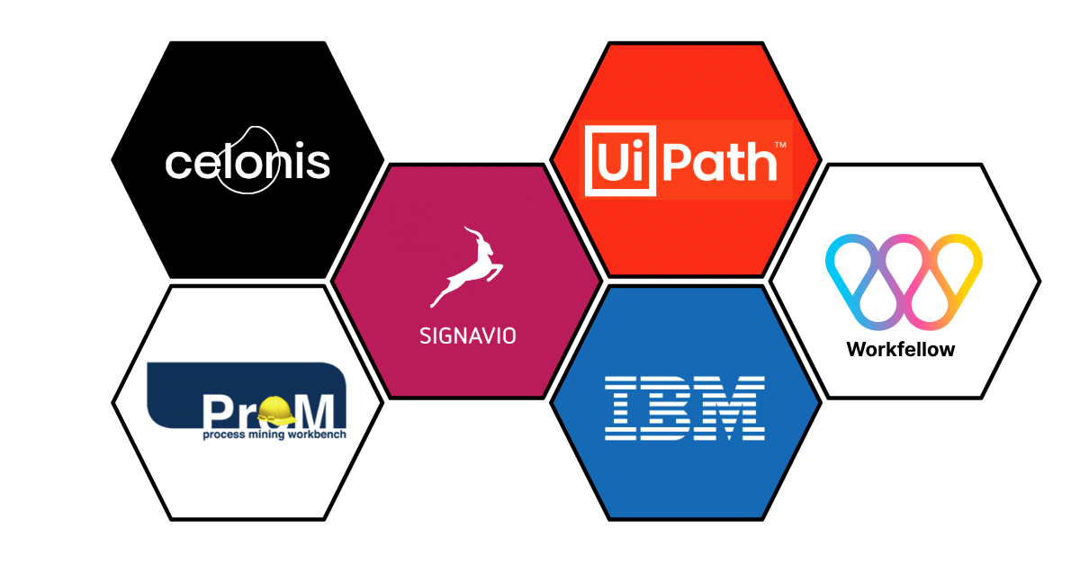
Process mining Tools
CELONIS
PROM
DISCO
MINIT
UIPATH…

Slide 17
Any Queries?

Slide 18
Thank You!!!

